Slide 1
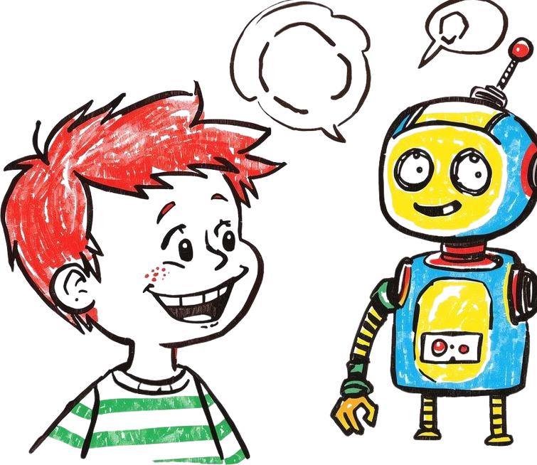
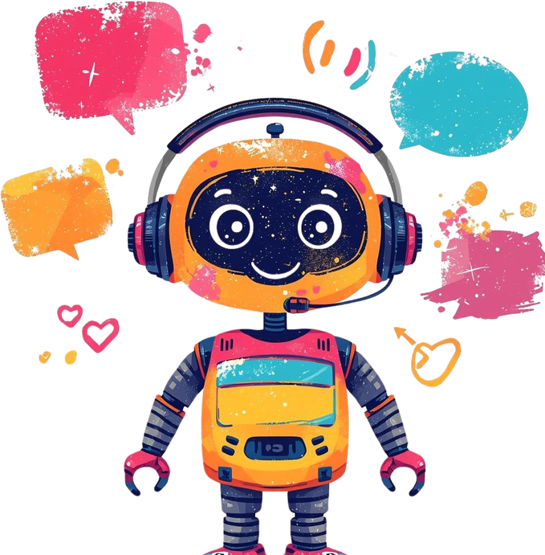
Day 3: Talking to
Computers –
Natural Language
Processing
How do computers understand what we say?

Slide 2

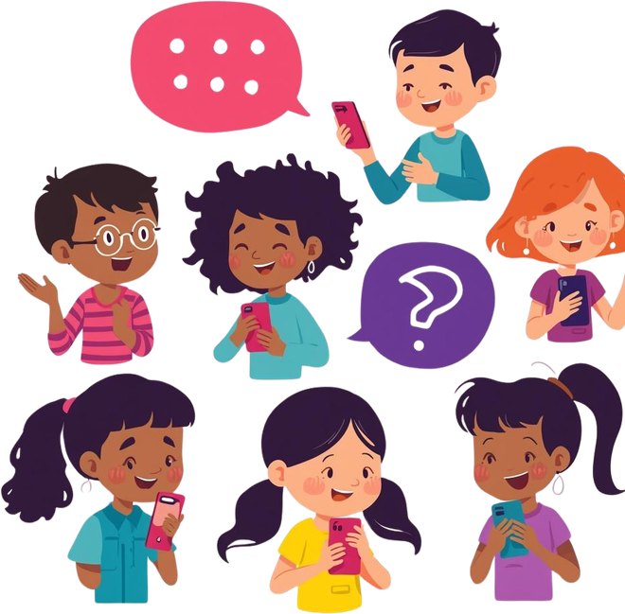
What is Natural Language Processing (NLP)?
Computers Can Understand Us!
NLP helps computers understand human language – like the words we speak and write!
You Already Use It Every Day!
When you talk, text, or ask questions – computers are learning to understand you!

Slide 3
Cool Examples of NLP You Know!
Hey Siri! Hey Alexa!
Voice assistants listen to your questions and find answers – that's NLP in action!
Chatbot Helpers
Chatbots can help you with homework, play games, or answer fun questions!
Autocorrect Magic
When you type "teh" and it fixes to "the" – that's NLP helping you spell!
Translation Apps
Apps that change "Hello" to "Hola" or "Bonjour" use NLP to understand languages!

Slide 4

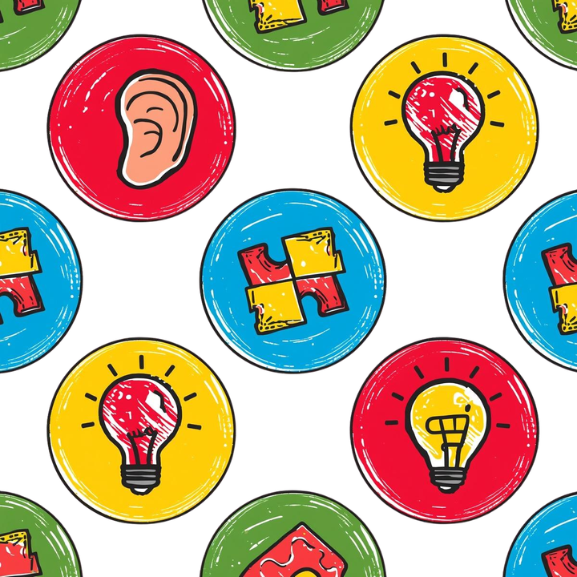
How Does NLP Work? A Simple Step-by-Step
1. Listen or Read
The computer hears your words or reads what you type – just like a friend listening to you!
1. Break It Down
It splits your sentence into pieces and figures out what each word means together.
1. Answer Time!
The computer gives you a helpful response – like playing your favorite song or answering a question!

Slide 5





Your Turn! Talk Computers!
to
What would you ask a computer if it could understand you perfectly? Try asking Siri, Alexa, or a chatbot something fun today! Keep exploring how computers learn to talk like us!

